Slide 1
Virtualizer Studio: TLM Creation
Quickstart Training – Model Debugging
© 2024 Synopsys, Inc. All Rights Reserved
Notes:
Welcome to the module 4 of the TLMC QuickStart training - Model Debugging!

Slide 2
CONFIDENTIAL INFORMATION
The information contained in this presentation is the confidential and proprietary information of Synopsys. You are not permitted to disseminate or use any of
the information provided to you in this presentation outside of Synopsys without prior written authorization.
IMPORTANT NOTICE
In the event information in this presentation reflects Synopsys’ future plans, such plans are as of the date of this presentation and are subject to change. Synopsys is not obligated to update this presentation or develop the products with the features and functionality discussed in this presentation. Additionally, Synopsys’ services and products may only be offered and purchased pursuant to an authorized quote and purchase order or a mutually agreed upon written contract with Synopsys.

Slide 3
Agenda
Introduction
  Virtualizer Studio Overview + TLM Creation Flow
Part 1: Model Skeleton Creation
  Model interfaces, memories, registers, build settings, IP-XACT import, etc.
Part 2: Test Driven Design Methodology
  Unit testing framework, test utilities, functional coverage, etc.
Part 3: Model Behavior Implementation
  Default and custom callbacks, continuous assignments, etc.
Part 4: Model Debugging
  SystemC debugging, using FastTrack messages, source code debugging, etc.
Part 5: Import of Existing SystemC Models
Part 6: Model Integration in Virtual Prototype Design
Notes:
Look into the overview to get an insight into the training contents.

Slide 4

Objectives
After completing this module, you should be able to understand the Model Debugging flow in the Virtualizer Studio environment:
Overview of the Model Debugging flow - VDK Debug perspective
Making your models intelligent and proactive by using the FastTrack Messages
Overview of the Embedded Source Code Debugging flow – Debug Perspective
  How to start a Debugging Session?
  Steps for debugging source code at a Breakpoint-Hit

Slide 5
Model Debug
VDK Debug – for Model Debugging
FastTrack
  Overview
  Messages in Simulation Output
  Messages Tracing
  Message Breakpoints
Notes:
In this module, we will look into the model debugging flow.

Slide 6
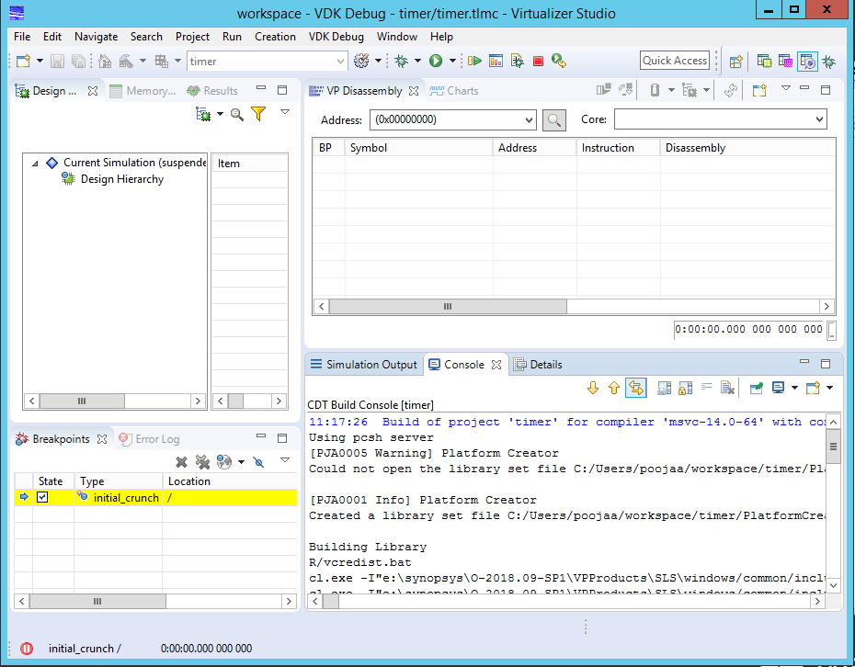
VDK Debug – for Model Debugging
VDK Debug perspective
Design Browser
VDK Debug helps you to perform the following:
Software debugging of the embedded software being integrated and developed on a virtual prototype
Tracing and Analysis, of hardware, software, and their interaction
Platform-level and model source-code-level SystemC debugging
For more details, refer to the VDK Debug training module
VP Disassembly view and Charts view
Console View and Simulation Output view
Breakpoints View
Notes:
Virtualizer Studio provides source code level debugging capabilities through a tight integration with the Microsoft Visual Studio, (MSVC) host debugger for Windows and through the built-in source code debug support for Linux host operating systems. For more details, refer to the Virtualizer Studio documentation.
In order to debug the unit tests, you can use the debug launch menu and run the component tests under control of the Source Code Debugger.
There is an additional control window for debugger control as there are two debuggers involved, one is the VP Explorer for the SystemC debug and introspection features, and a standard GDB source code debugger. Each can have breakpoints, and simulation can be stopped. You can set, which run should be controlled by the Run, Continue and Stop buttons on the toolbar, from this window itself.

Slide 7
FastTrack – Overview
Helps in making your models intelligent and proactive rather than being just compiled black box models
FastTrack Messages
  Implicit - Added by default such as writing to a read-only register
  Explicit – To be added by model author for specific model behavior
FastTrack supported severity levels
  Errors
  Info
  Warning
  Model Internal
  For more details, refer to the TLMC Training Session 2 – Test Driven Design Methodology. In this module, we will look at how to make use of the FastTrack messages in debugging.
Notes:
The Virtualizer FastTrack technology provides a means of instrumenting the TLM model behavior with FastTrack messages which at run-time, provide additional information to the user of the model, about its specific execution state. Examples of this could be the wrong programming of a model, e.g. writing to a read-only register, or the model transition to an illegal state, as well as other situations like the indication that certain model behavior hasn’t been implemented yet.
The result of this unique feature is that the use of these models for embedded software development and debugging, becomes much more productive compared to other hardware alternatives, as the models can proactively flag erroneous conditions, wrong programming, etc. to the user. Along the same line, as another benefit these FastTrack messages make the model debugging, both during the development and later during its use, greatly more efficient, as they are no longer just compiled black box models, but rather intelligent proactive models.

Slide 8
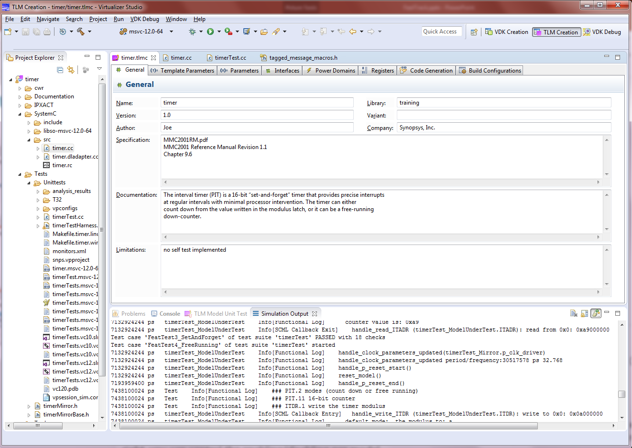
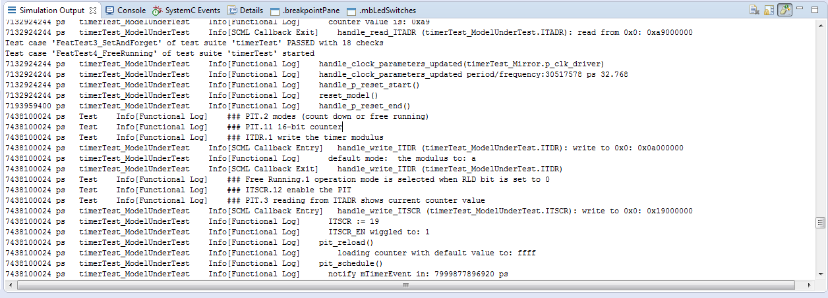
FastTrack Messages in Simulation Output
FastTrack messages appear in the Simulation Output view
Notes:
The first main feature is the output of messages at run-time. When enabled, FastTrack messages will appear in the Simulation Output view as regular messages, which can be used to provide more in-depth information.

Slide 9
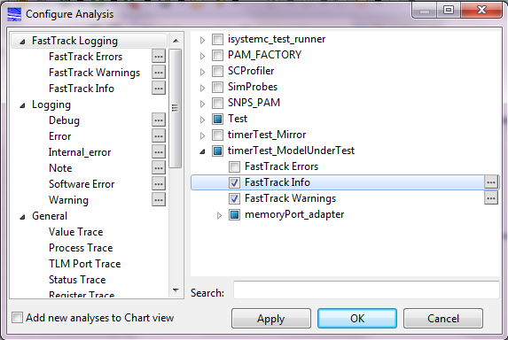
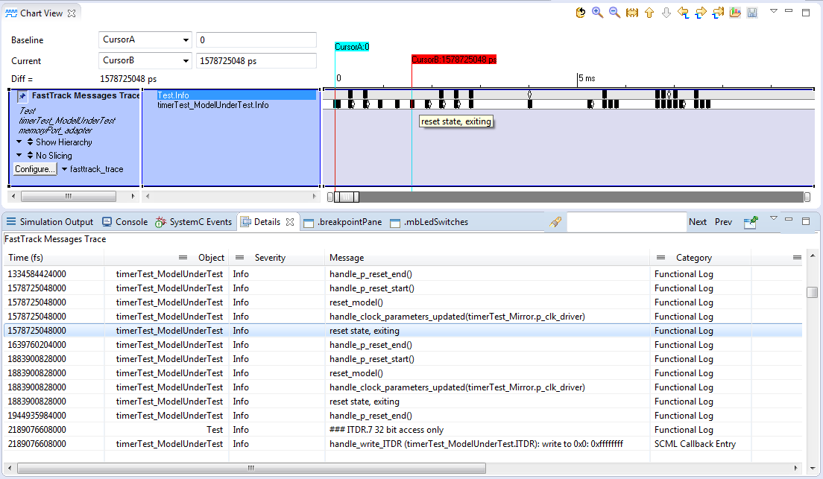
FastTrack Messages Tracing
FastTrack Chart view used to visualize the FastTrack messages over time
Configure Analysis
Configuring FastTrack Logging Trace option from the Configure Analysis dialog
Details view showing the FastTrack messages details
Enabling/Disabling the FastTrack messages for all the TLM models
Notes:
The second main feature is the tracing over time of the FastTrack messages.
The configuration of the tracing of FastTrack messages can be done with the help of the Configure Analysis dialog in the VDK Debug perspective of Virtualizer studio, which is also used for controlling other types of tracing. You can enable this trace in 3 main Severity levels, Errors, Warnings and Info. In the right pane, you can control the enabling or disabling for each model being used in the virtual prototype.
The dedicated FastTrack chart view allows to conveniently visualize the FastTrack messages over time, and correlate them with other events happening in the virtual prototype.
The Detail view is to be used in combination with the FastTrack chart for better debugging. It provides capabilities like filtering, searching, etc. to quickly find the messages you’re interested in. As an advanced feature, the Details view also allows you to correlate the FastTrack messages to the embedded software running on one or more of the embedded cores in the virtual prototype.

Slide 10
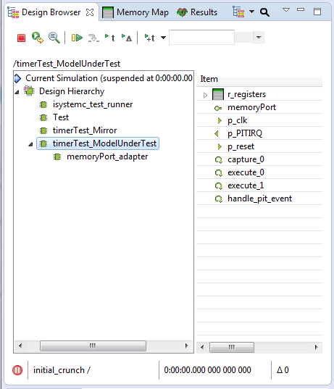
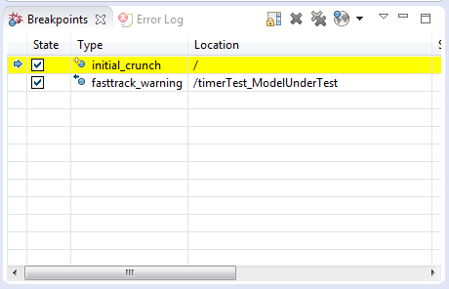
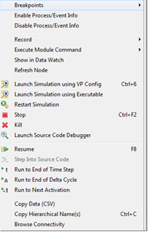

FastTrack Message Breakpoints
Use the Design Browser to set FastTrack breakpoints. Right-click on the component & select ‘Breakpoints’ option
Design Browser
The FastTrack breakpoints appear in the Breakpoints view
Select the desired FastTrack breakpoint
Notes:
Thirdly, FastTrack breakpoints allow to suspend the simulation, when a message of either a Warning or Error severity occurs. You can use the Design Browser to select the component, right-click and select ‘Breakpoints’. Then, select the desired FastTrack breakpoint to be set. The FastTrack breakpoint will be shown in the Breakpoints view.
Virtualizer Studio is a full-fledged integrated development environment, or IDE, for TLM models. Lets revisit its capabilities next.

Slide 11
Source Code Debugging
  Source Code Debugging Overview
  How to start a Debugging Session
  Debugging Source Code at a Breakpoint Hit
Notes:
In this section, we will look into the source code debugging flow supported in Virtualizer Studio.

Slide 12
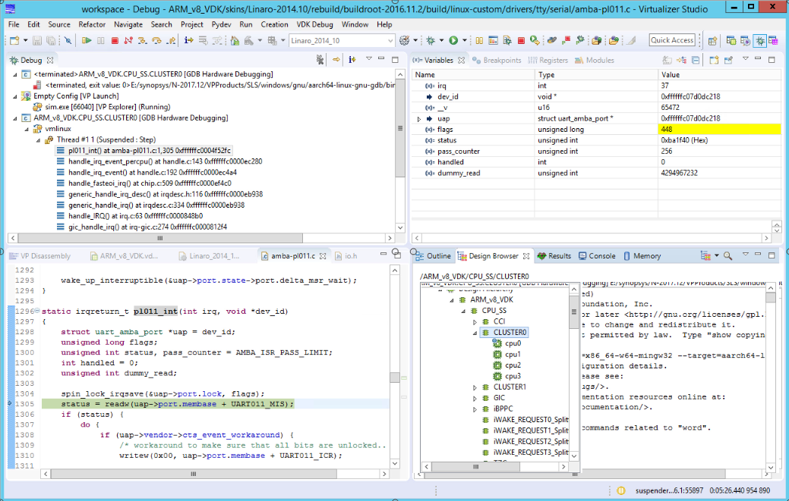
Component Testing – Source Code Debugging
Debug perspective
Debug Perspective
Built-in completely integrated source code debug support (Debug perspective)
Fully integrated GDB Debugger
Support for Multicore debugging
Multiple views in a single integrated IDE
Notes:
Virtualizer Studio provides source code level debugging capabilities through the built-in source code debug support, the Debug perspective and a tight integration with the Microsoft Visual Studio, (or MSVC in short) host debugger for Windows. For more details, refer to the Virtualizer Studio documentation.
In order to debug the unit tests, you can use the debug launch menu and run the component tests under control of the Source Code Debugger.

Slide 13
Component Testing – Source Code Debugging
Run Controls for GDB
Run Controls for VPX
Debug perspective
Debug View
Variable view
Check the value change of the variables interactively with every step
Design Browser
Model
Source Code
Review the value of the design components on runtime with each step
Source code for the current execution point of the running process
Suspended Target information in the Status bar
Notes:
There is an additional control window for debugger control as there are two debuggers involved, one is the VP Explorer for the SystemC debug and introspection features, and a standard GDB source code debugger. Each can have breakpoints, and simulation can be stopped. You can set, which run should be controlled by the Run, Continue and Stop buttons on the toolbar, from this window itself.

Slide 14
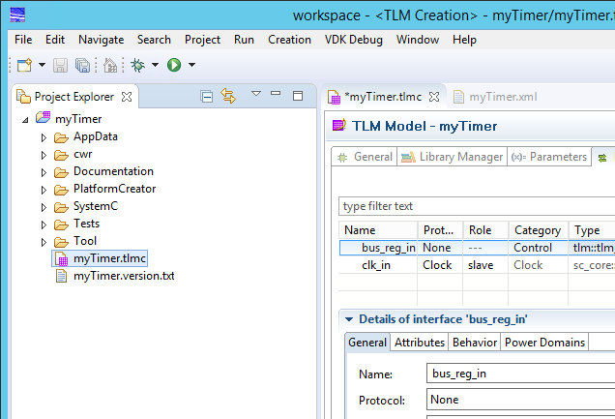
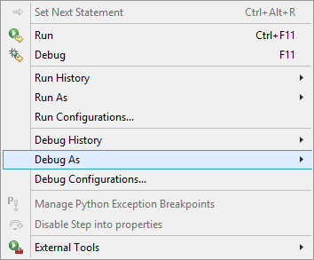

How to Start a Debugging Session
Expand Debug options
Click Run menu
Click to start a debugging session
Click to start a debugging session
Notes:
In order to debug the unit tests, you can use the debug launch menu and run the component tests under control of the Source Code Debugger.

Slide 15
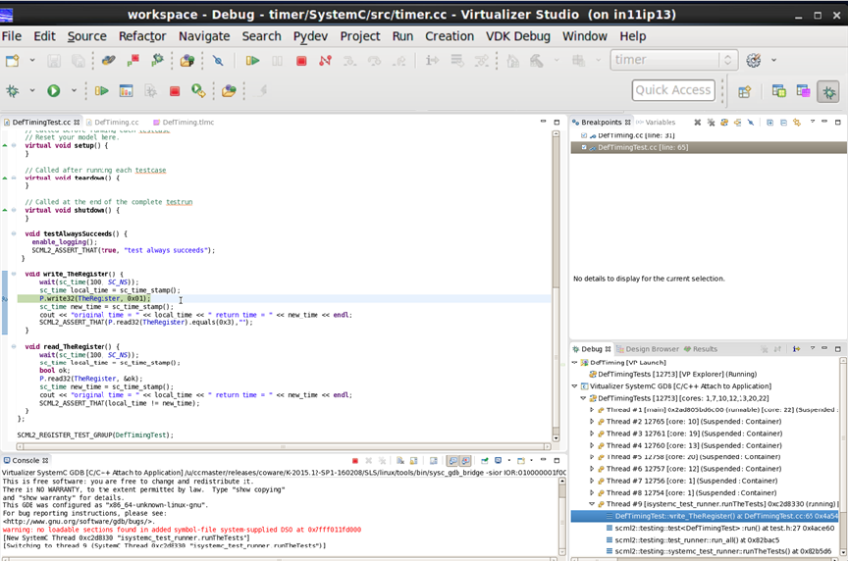

Debugging Source Code at a Breakpoint Hit
Breakpoints
Source Code Debugging from the Debug Perspective
Source code at the breakpoint hit
Notes:
You can set breakpoints in the model code as well as the test code, and use the standard C++ debugging features of eclipse. You can use these capabilities in combination with the SystemC-aware debugging provided in Virtualizer Studio such as, placing a SystemC breakpoint at the activation of one or more SystemC threads of a specific model. Once you hit the SystemC breakpoints, you can seamlessly step into the source code of the model, where simulation control is handed off automatically to the host debugger.

Slide 16
Hands On Labs on this topic
Module 1 Lab D: Model Debugging
Your task is to use the embedded source code debugging flow to debug some of the model implementation glitches
Notes:
Accompanied Lab Modules Overview !

Slide 17

Thank You

